Slide 1
Lambda,map,filter, Iterators and generator functions yield
Chapter 10
Notes:
Note from Chuck. If you are using these materials, you can remove the UM logo and replace it with your own, but please retain the CC-BY logo on the first page as well as retain the acknowledgement page(s) at the end.

Slide 2
lambda
A lambda function is a small anonymous function.
A lambda function can take any number of arguments, but can only have one expression.

Slide 3
lambda
Syntax
lambda arguments : expression
The expression is executed and the result is returned

Slide 4
Lambda example
fun1 = lambda a : a + 10
print(fun1(5))
fun2 = lambda a, b : a * b
print(fun2(5, 6))
fun3 = lambda a, b, c : a + b + c
print(fun3(5, 6, 2))

Slide 5
Why Use Lambda Functions?
The power of lambda is better shown when you use them as an anonymous function inside another function.
Say you have a function definition that takes one argument, and that argument will be multiplied with an unknown number
Use that function definition to make a function that always doubles the number you send in:

Slide 6
Example
def myfunc(n):
return lambda a : a * n
mydoubler = myfunc(2)
mytripler = myfunc(3)
print(mydoubler(11))
print(mytripler(11))

Slide 7
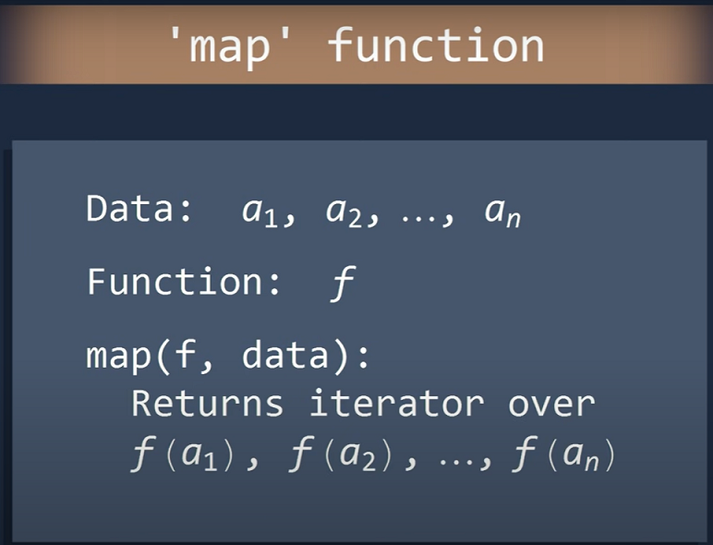

Slide 8
Map example
import math
area=lambda r:r**2*math.pi
radiiList=[2,5,7.1,0.3,10]
m=map(area,radiiList)
print(m) # m is a map object
lm=list(m)
print(lm)

Slide 9
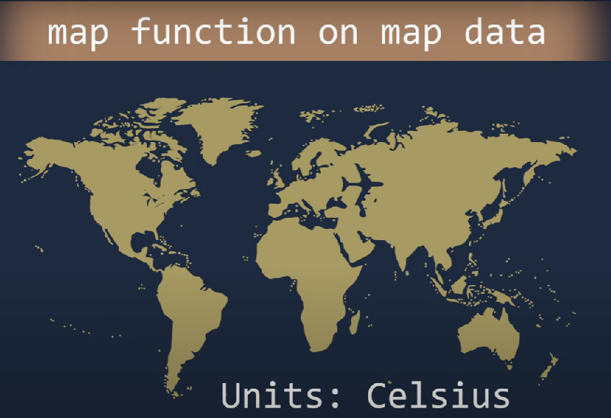
Map example

Slide 10
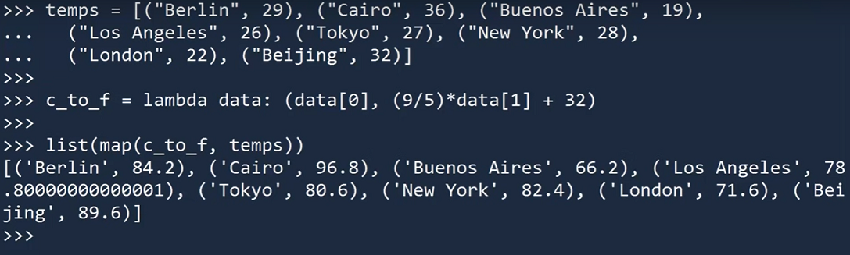
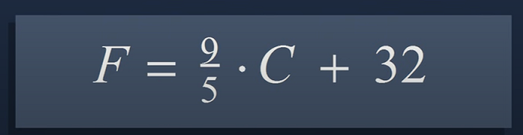
Map example

Slide 11
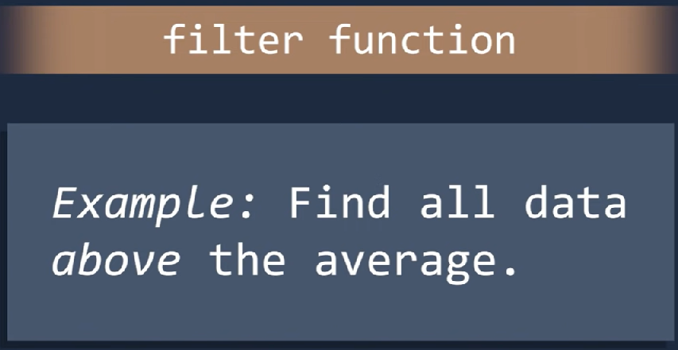
filter

Slide 12
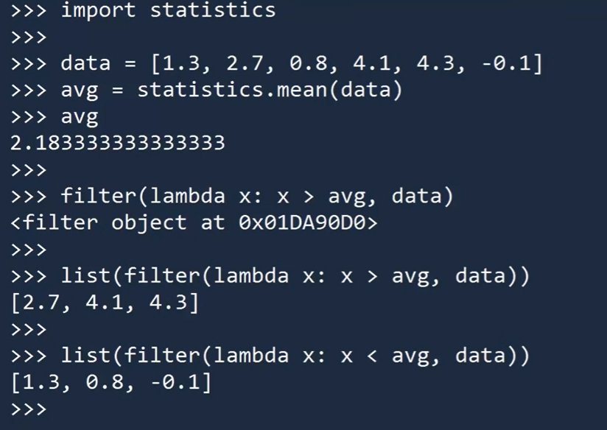
filter

Slide 13
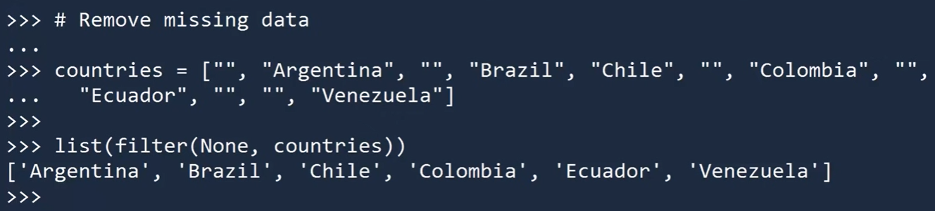
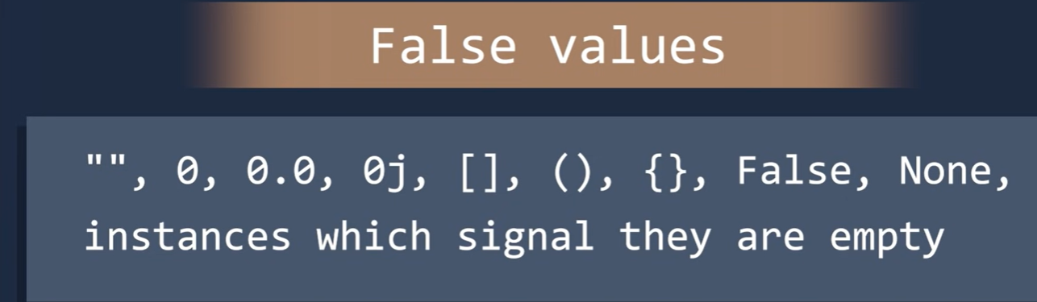
filter

Slide 14
Iterators
An iterator is an object that contains a countable number of values.
An iterator is an object that can be iterated upon, meaning that you can traverse through all the values.
Technically, in Python, an iterator is an object which implements the iterator protocol, which consist of the methods __iter__() and __next__().

Slide 15
Iterator vs Iterable
Lists, tuples, dictionaries, and sets are all iterable objects. They are iterable containers which you can get an iterator from.
All these objects have a iter() method which is used to get an iterator:

Slide 16
Example Return an iterator from a tuple, and print each value:
mytuple = ("apple", "banana", "cherry")
myit = iter(mytuple)
print(next(myit))
print(next(myit))
print(next(myit))
apple
banana
cherry

Slide 17
Example strings are iterable objects, and can return an iterator:
mystr = "banana"
myit = iter(mystr)
print(next(myit))
print(next(myit))
print(next(myit))
print(next(myit))
print(next(myit))
print(next(myit))
b
a
n
a
n
a

Slide 18
Looping Through an Iterator: We can also use a for loop to iterate through an iterable object:
Iterate the values of a tuple:
mytuple = ("apple", "banana", "cherry")
for x in mytuple:
print(x)
apple
banana
cherr

Slide 19
Looping Through an Iterator: We can also use a for loop to iterate through an iterable object:
Iterate the characters of a string:
b
a
n
a
n
a
mystr = "banana"
for x in mystr:
print(x)

Slide 20
Looping Through an Iterator: We can also use a for loop to iterate through an iterable object:
Iterate the characters of a string:
b
a
n
a
n
a
mystr = "banana"
for x in mystr:
print(x)
The for loop actually creates an iterator object and executes the next() method for each loop.

Slide 21
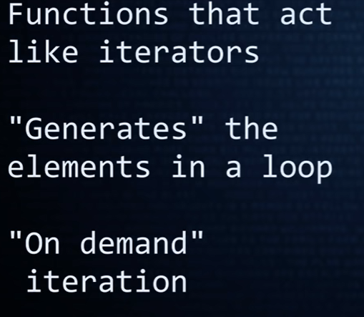
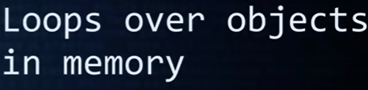
generator functions yield

Slide 22
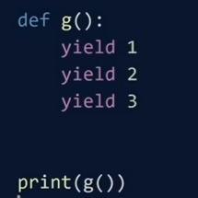
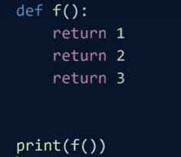
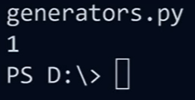
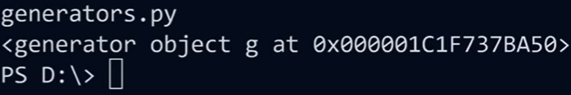
generator functions yield

Slide 23
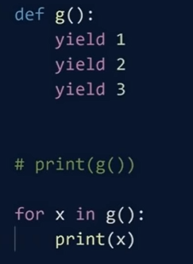
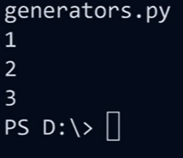
generator functions yield

Slide 24

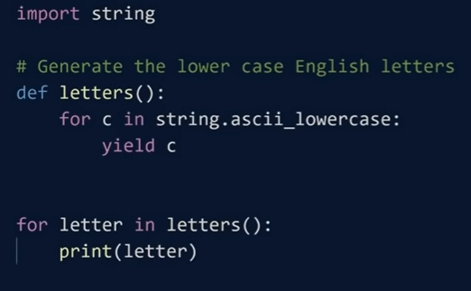
generator functions yield

Slide 25
Summary
Lambda
Map
Filter
generator functions yield
iterators

